Slide 1
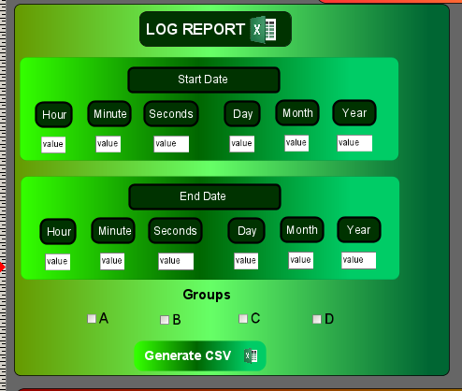
Question no 1
What are the changes to be made the below code to generate
log table like this in viewon

Slide 2
Download Historical Table Report
var smonth = document.getElementById("UID_1618316373773").value;
var sday = document.getElementById("UID_1618316366288").value;
var syear = document.getElementById("UID_1618316379935").value;
var emonth = document.getElementById("UID_1618316377101").value;
var eday = document.getElementById("UID_1618316369054").value;
var eyear = document.getElementById("UID_1618316382164").value;
var date = "$st" + sday + smonth + syear + "_000000$et" + eday + emonth + eyear + "_000000";
var yourfile = "$dtHT$ftT$fnIot Log.csv" + date;
var url = "http://IP/rcgi.bin/ParamForm?AST_Param=" + yourfile;
window.open( url , "download"); //downloads the file that was just generated

Slide 3
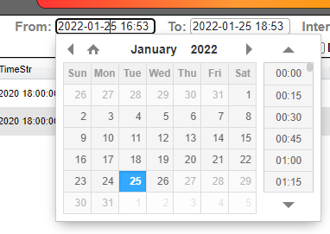
Question no 2
Instead of 1st picture start date, can I add direct calendar to pic the start date in ViewON. If its possible how modify the same code plz guide.

